Slide 1
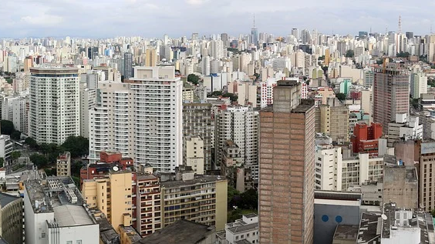
Case Study: “Is it Worthy to Build a House in SP Today?”
Vinicius da Silva, January 2022

Slide 2
Summary
Objective
Inspiration
Questions
Data Source
Analysis
Recommendations
Suggestions for further analysis

Slide 3
Objective
Identify if this is a good moment to build a house in São Paulo by analyzing time series data.

Slide 4

Inspiration
Got married in August, 2021.
We decided to finish building our own house because we didn’t want to rent one.
High prices made us question our decision.

Slide 5
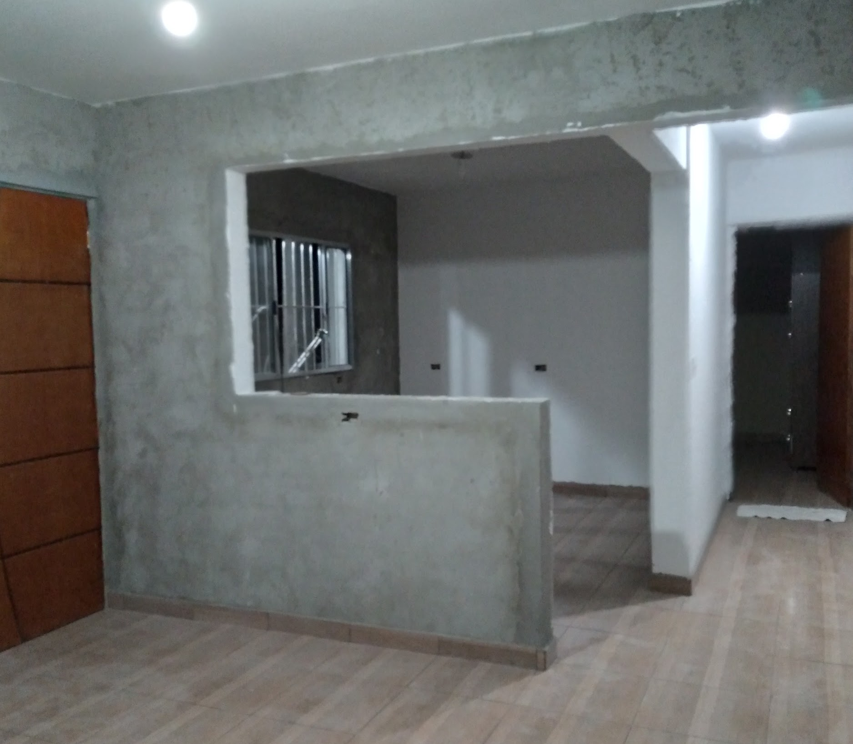
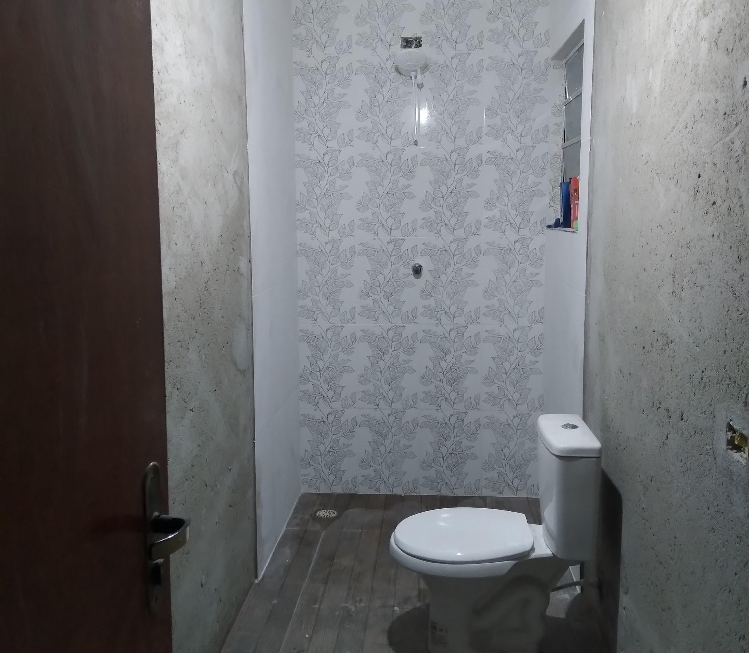
The house was still under construction when we moved in.

Slide 6
I focused my data search on the following questions:

Slide 7
How has the cost of building a simple residence been changing over the years?
How does this variation reflect on construction materials and labor separately?
What is the trend for the next months?

Slide 8
I collected data furnished by the following organizations to answer my questions:

Slide 9

Stands for São Paulo Civil Construction Syndicate.
They provide the construction cost per square meter (R$/m²) of different building categories.
I focused my analysis on the R1-B category (residence including 2 bedrooms, 1 bathroom, 1 kitchen, 1 living room and 1 laundry room within 1 floor)

Slide 10

Stand for Getúlio Vargas Foundation and Brazilian Institute of Economics.
They provide the national civil construction inflation rate (INCC) since January 1944, considering factors like labor, services and different materials.

Slide 11

Stands for Brazilian Institute of Geography and Statistics.
They provide the Broad National Consumer Price Index (IPCA) or the official inflation index considered by the government. It is different from the INCC because it considers family spending in general (not only civil construction).

Slide 12
The Analysis

Slide 13
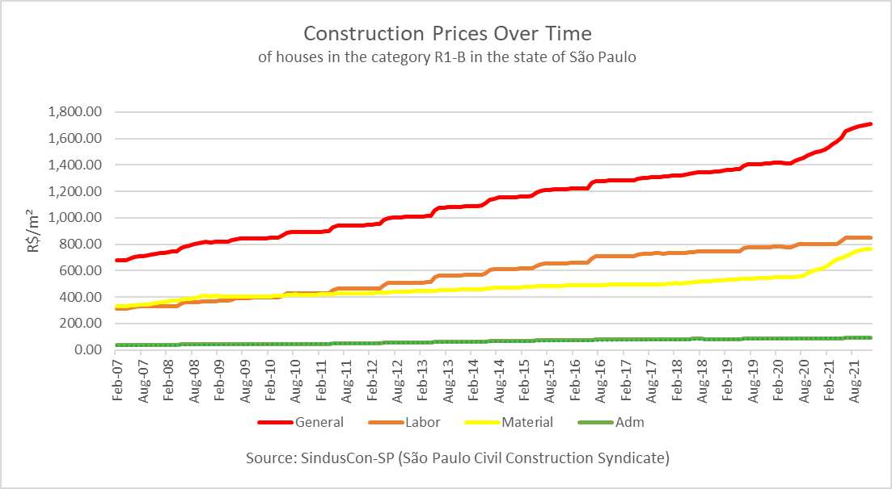
Prices naturally have increased over time in all components.
Notice how in recent months material prices have increased more rapidly, influencing total cost to do the same.

Slide 14
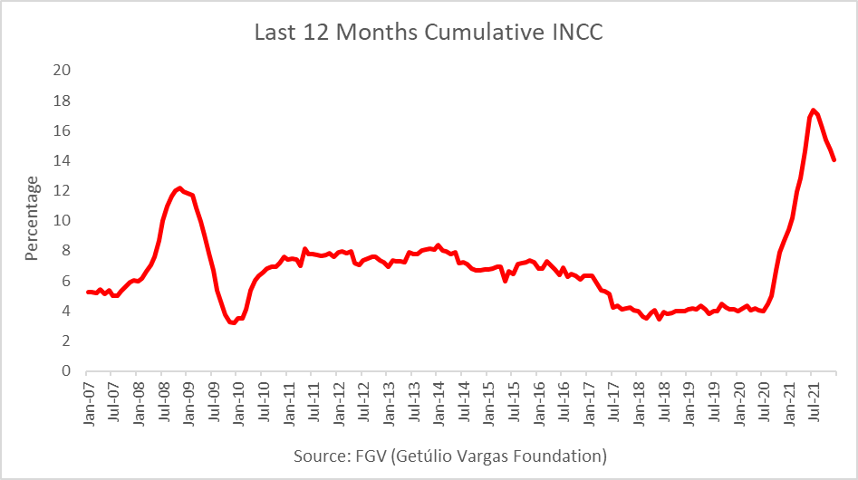
That rapid increase is clearly reflected in inflation reports.
We had never seen a peak like this for at least a decade.

Slide 15
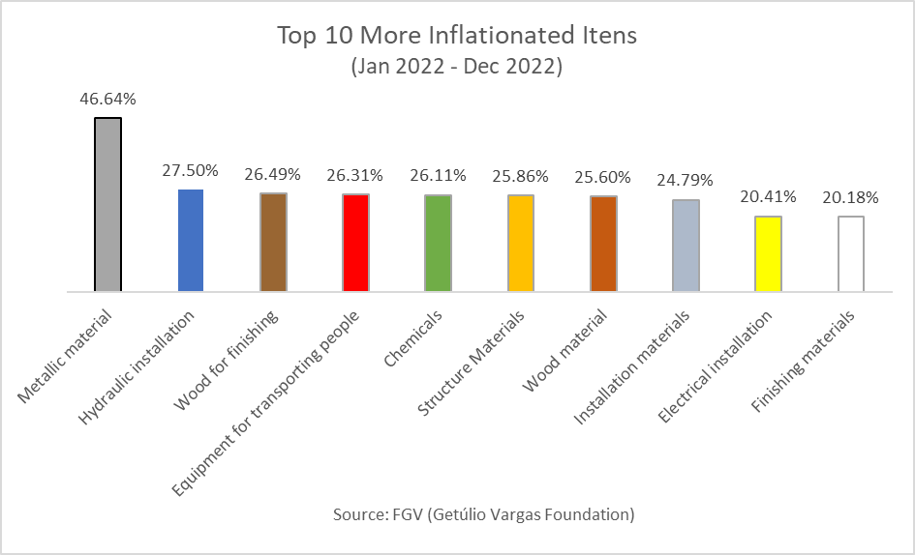
Again, we see how this rapid price variation is affecting especially building materials instead of labor.
Metallic materials were the most affected.

Slide 16
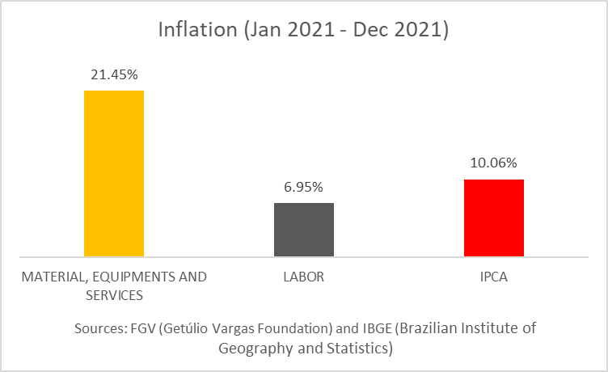
Construction materials valuation was more than double the average of items included in household spending.
Also, construction inflation could be even worse. Workers have lost buying power and could attempt to correct that.

Slide 17
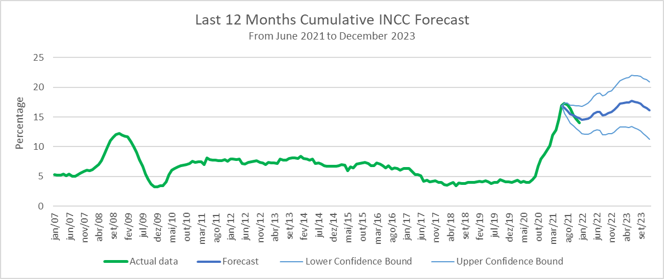
We should expect a similar scenario for the next few months as the pandemic situation continues.
Then there’s a 95% chance that cumulative INCC will remain above 10% and maybe get close to 20% in 2023.

Slide 18
Recommendations
If construction can’t be postponed, constructors should expect prices increasing rapidly. My recommendations are the following:

Slide 19



Purchase materials in larger quantities soon.
Hurry to finish in 2022 Q1 or ASAP.
Research prices and choose other brands if needed.

Slide 20
Suggestions for further analysis:
Analyse inflation effects on house renting to determine what is the best alternative in the current situation.
Analyse other economic factors to understand material prices variation and make predictions.

Slide 21
Thank you!

